Slide 1
Assembly Language Programming Intel 8088/8086 Processor
Dr.N.Arulanand, Professor,
PSG College of Technology

Slide 2
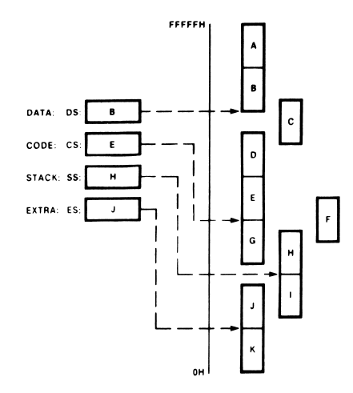

Memory Segment
Only four of these 64Kbyte segments are active at a time:
Code is always fetched from memory as words, not as bytes

Slide 3
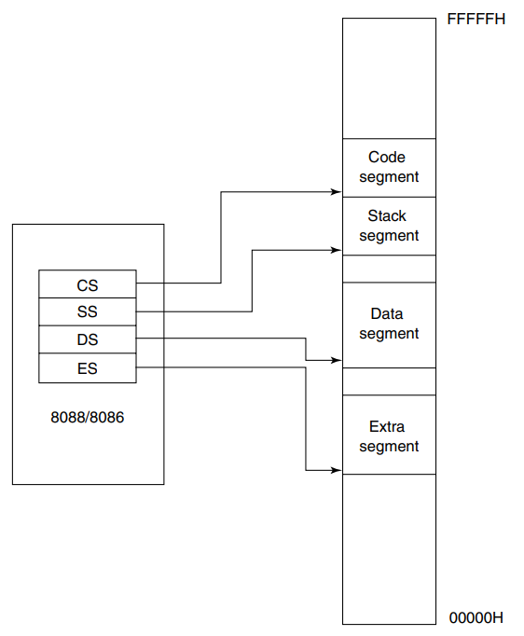
Active Segments of the Memory
The Segment registers are user accessible
Programmer can change the contents through software
For Example: new data space upto 128 kbytes is brought simply by changing the values in DS and ES register
Restriction: The address must reside on a 16-byte boundary. Valid addresses are 00000H,00010H,00020H
Segments can be continuous, adjacent, disjointed or even overlapping

Slide 4
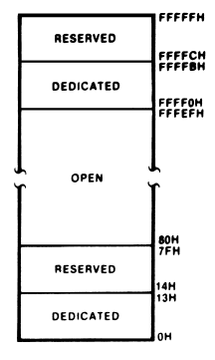

Dedicated and Reserved Address Spaces
00H to 7FH (128 bytes) of memory are used to store the pointers to interrupt service routines.
The dedicated part is used to store the pointers for the 8088’s internal interrupts and exceptions.
The reserved locations are used by the user-defined interrupts

Slide 5
Instruction Pointer (IP)
IP identifies the location of the next word to be fetched
Looks similar to Program Counter. However, contains the offset address instead of its actual address
CS is 16-bit in length, IP is 16-bit in length
Value of next code address is CS:IP
IP is incremented by 2 bytes

Slide 6
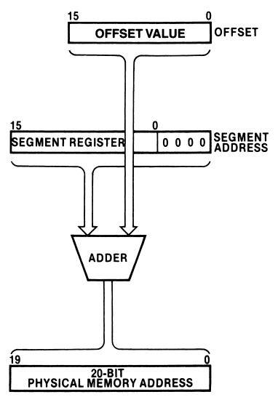
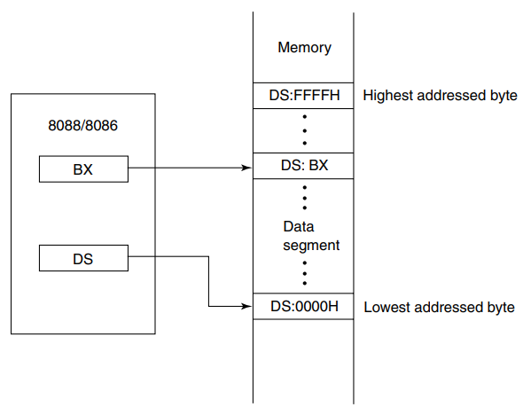
Generating a Memory Address
The generation of the physical address involves combining a 16-bit offset value that is located in the instruction pointer, a base register, an index register, or a pointer register and a 16-bit segment base value that is located in one of the segment registers.
CS:IP
DS:DI
SS:SP
Segment Base Register – represent the starting location of the 64K byte segment .i.e., the lowest byte in the segment

Slide 7
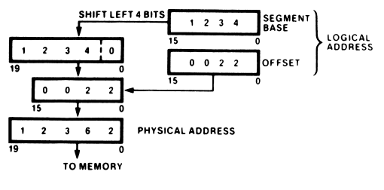
Physical Address Calculation

Slide 8
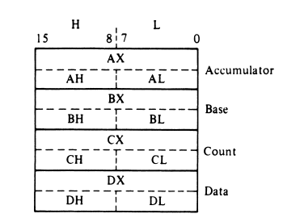
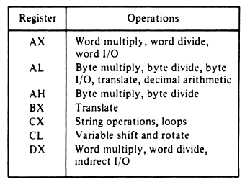
Data Registers
The accumulator register (A), the base register (B), the count register (C), and the data register (D)
These names imply special functions they are meant to perform for the microprocessor. Notice that string and loop operations use the C register.
For example, the value in the C register is the number of bytes to be processed in a string operation. This is the reason it is given the name count register.
Another example of the dedicated use of data registers is that all input/output operations must use accumulator AL or AX for data
For the A register, the most significant byte is referred to as AH and the least significant byte as AL

Slide 9
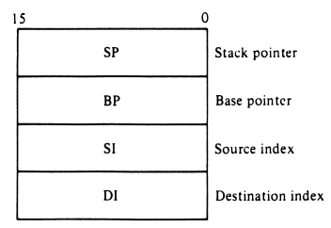
Pointer and Index Register
The values in SP and BP are used as offsets from the current value of SS during the execution of instructions that involve the stack segment of memory
combining SP with the value in SS (SS:SP) results in an address that points to the top of the stack (TOS)
BP also represents an offset relative to the SS; however, it is used to access data within the stack segment of memory.
One common use of BP is to reference parameters that are passed to a subroutine by way of the stack.
Source index (SI) register holds an offset address that identifies the location of a source operand
Destination Index (DI) register holds location of destination operand
DS or ES register are used along with the Index Register

Slide 10
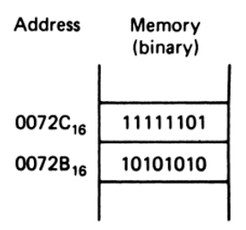
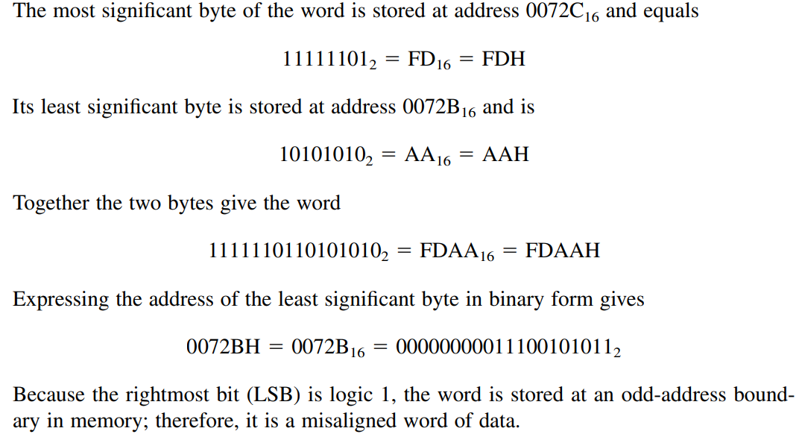
Solution
Little Endian:
Lower order Byte is stored first and then higher order byte.

Slide 11
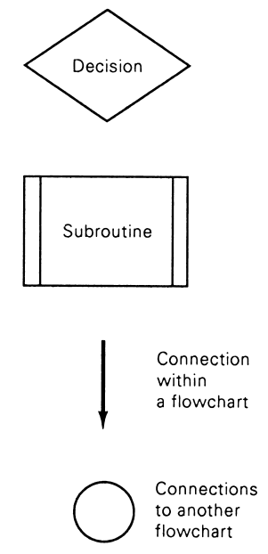
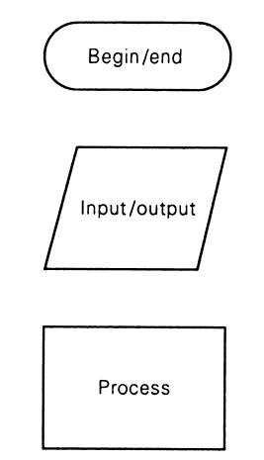
Flowchart symbols

Slide 12
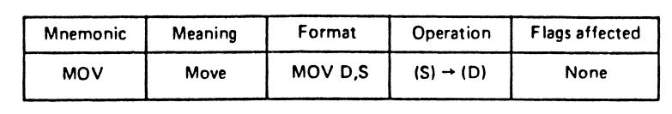
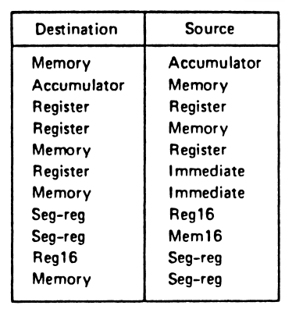
MOVE INSTRUCTION
The format is
MOV D, S
D – destination operand
S – Source operand
Allowed MOV Operations are \
shown here

Slide 13
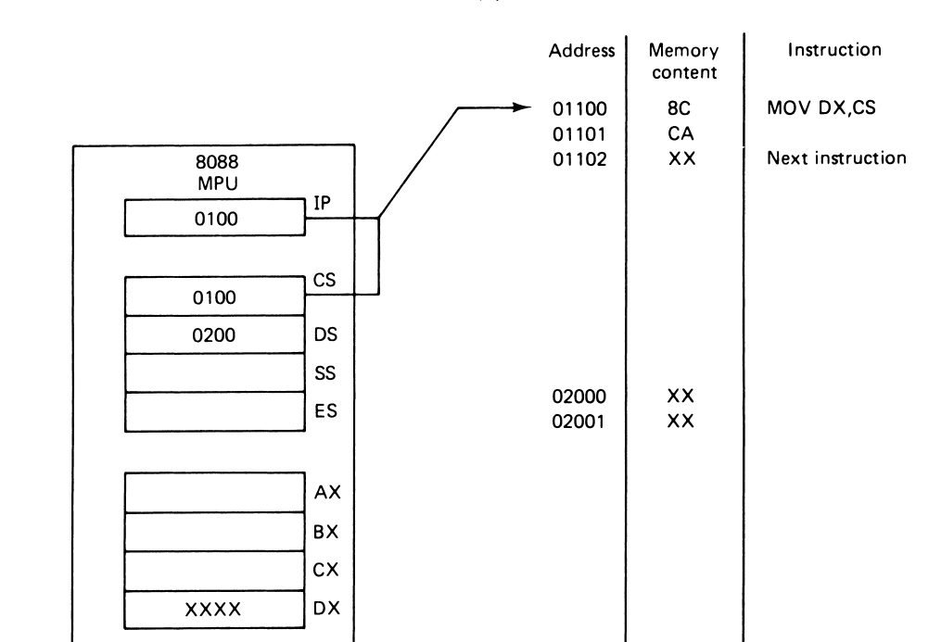
Example of MOV Instruction

Slide 14
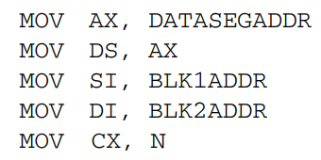
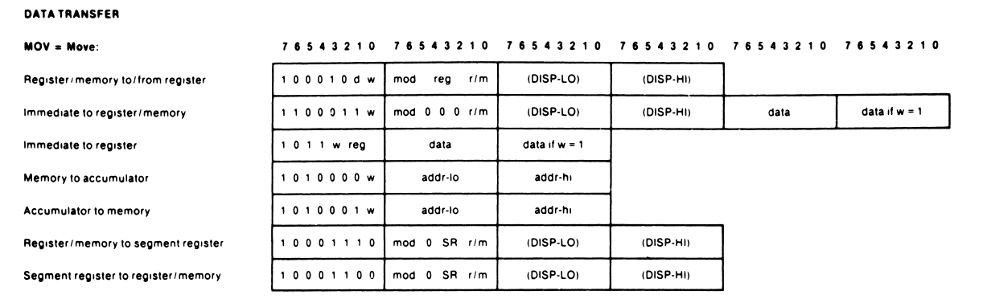
Machine Code Instruction

Slide 15
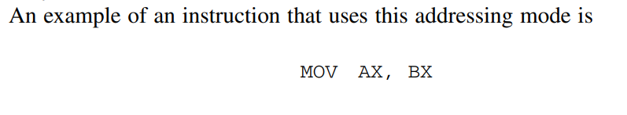
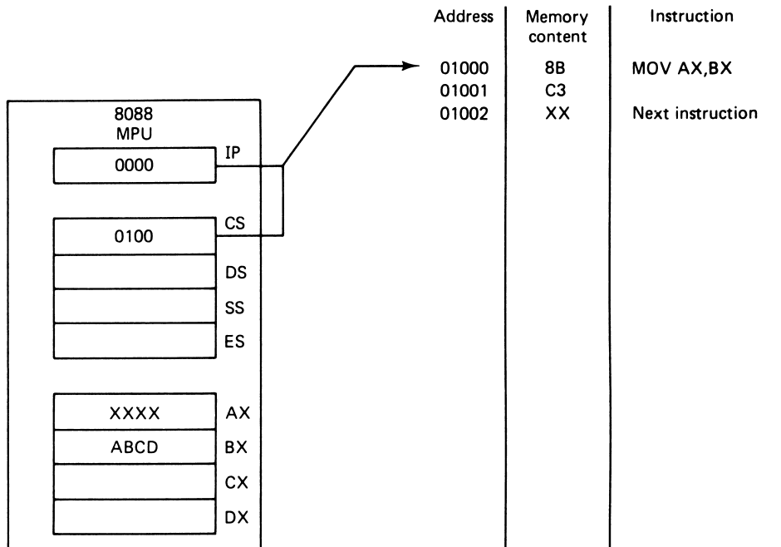
Register Operand Addressing Mode

Slide 16
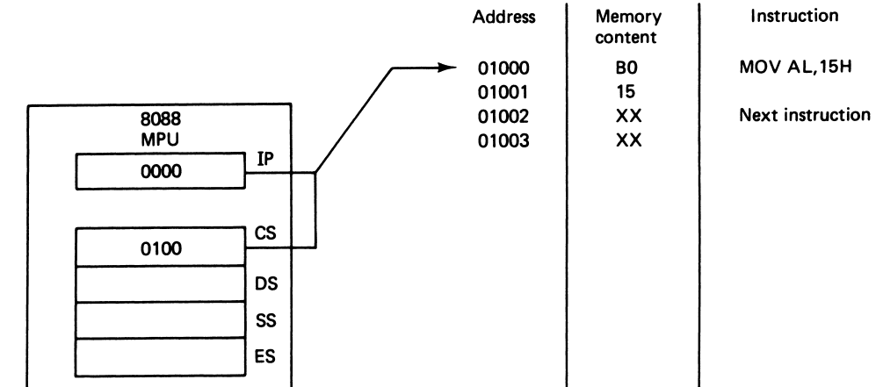
Immediate Operand Addressing Mode

Slide 17
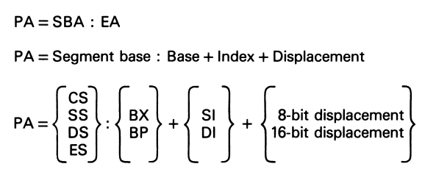
Memory Operand Addressing Mode
Physical Address (PA) = Segment Base Address (SBA) + Effective Address (EA)
Effective address represent the offset of the operand from the beginning of this segment in memory
A number of memory addressing modes are defined by using various combinations of these elements. They are called register indirect addressing, based addressing, indexed addressing, and based-indexed addressing

Slide 18
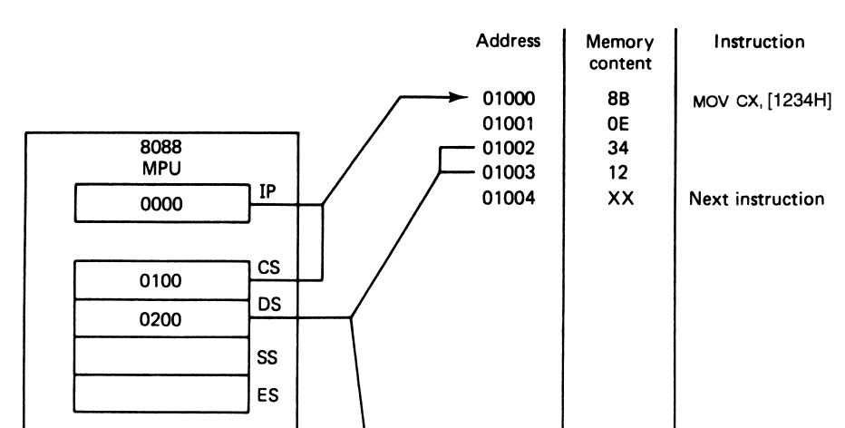
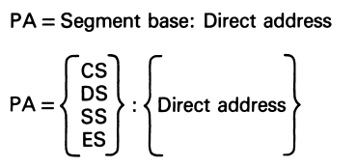

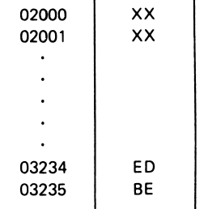
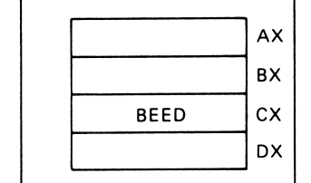
Direct Addressing Mode

Slide 19
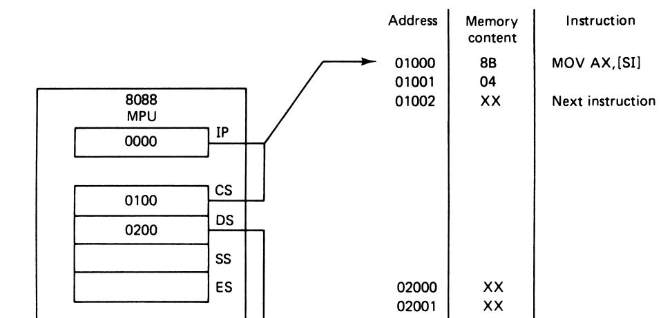
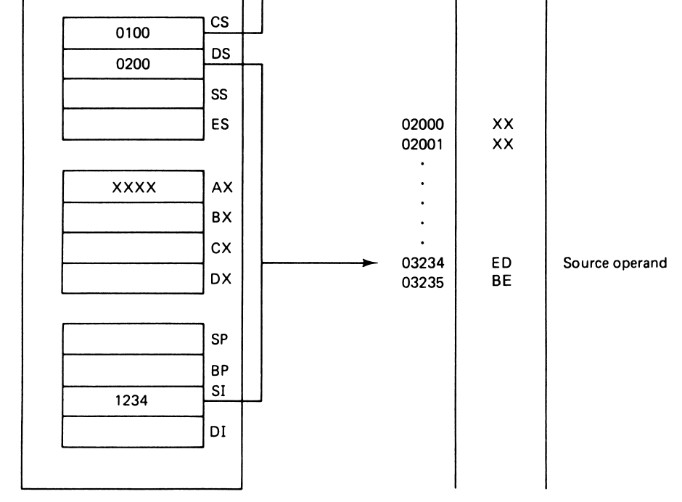
Register Indirect Addressing Mode
NOTE: The default segment register is DS (Data Segment)
Register indirect addressing mode is similar to the direct addressing we just described in that an effective address is combined with the contents of DS to obtain a physical address

Slide 20
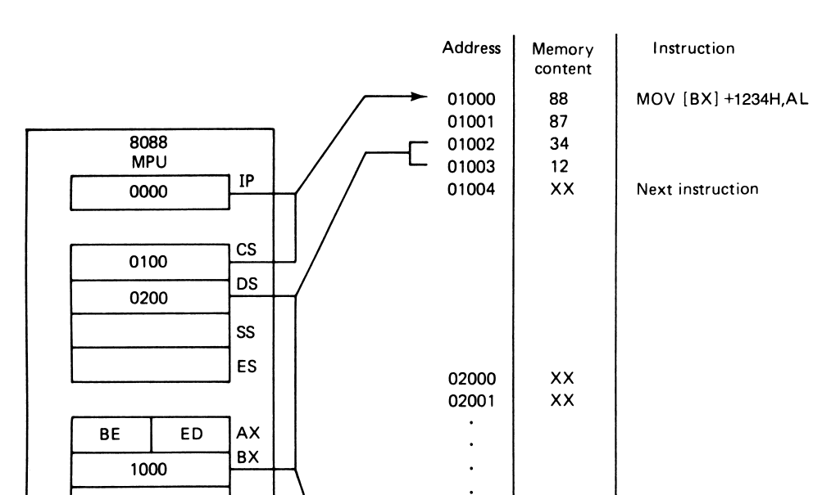
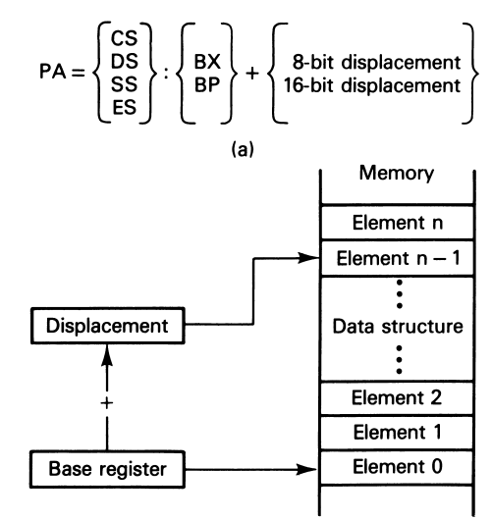
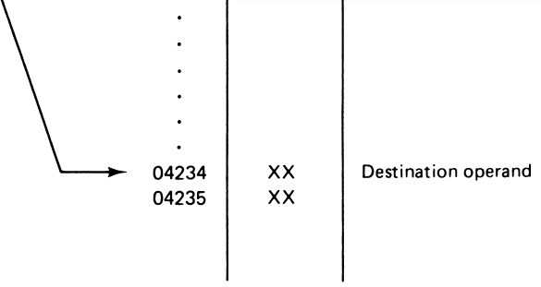

Based Addressing Mode
In the based addressing mode, the effective address of the operand is obtained by adding a direct or indirect displacement to the contents of either base register BX or base pointer register BP

Slide 21
Based Addressing Mode
If BP is used instead of BX, the calculation of the physical address is performed using the contents of the stack segment (SS) register instead of DS. This permits access to data in the stack segment of memory

Slide 22
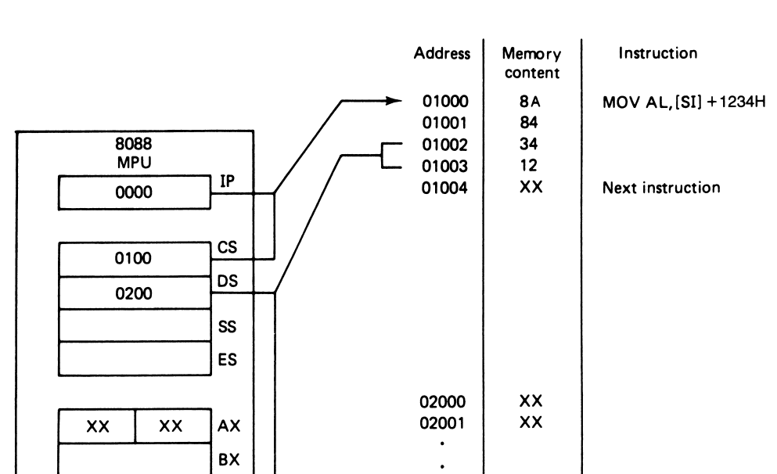
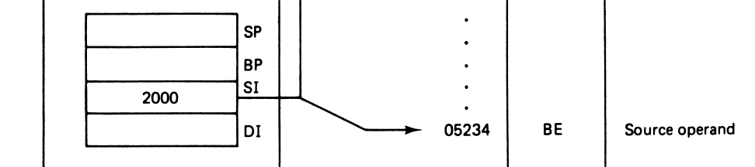
Indexed Addressing Mode

Slide 23
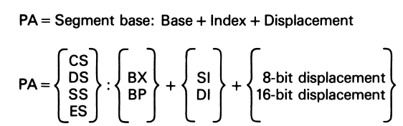
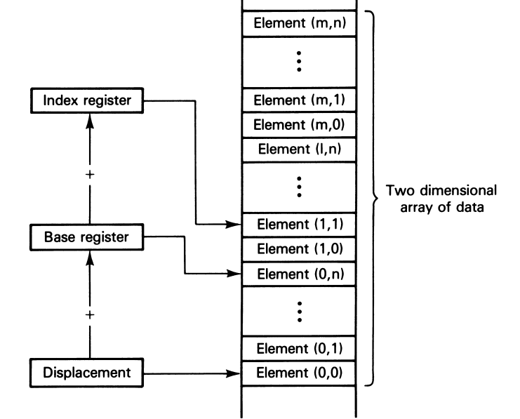
Based Indexed Addressing Mode

Slide 24
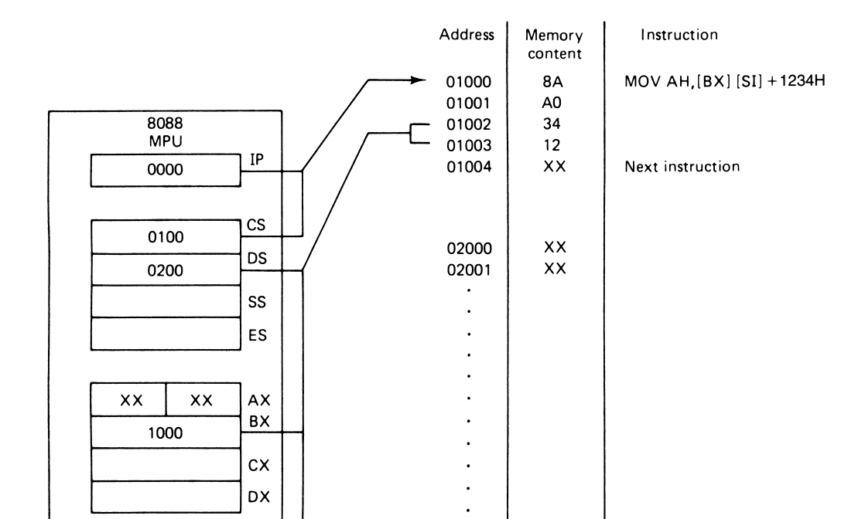

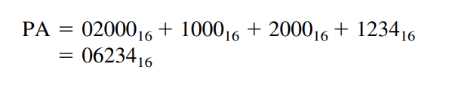
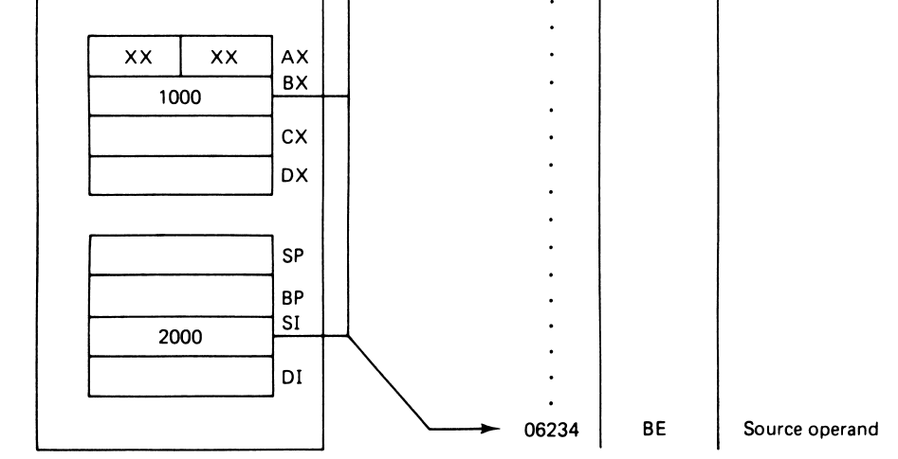
Example

Slide 25
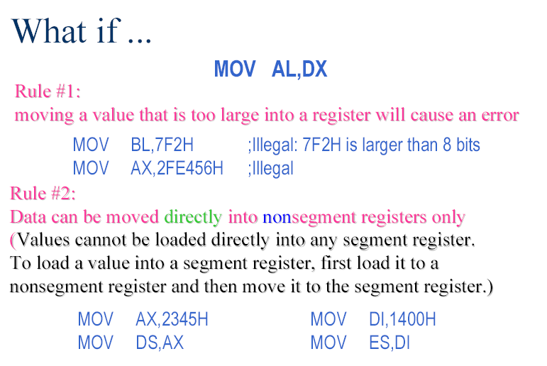
Rule #3:
If a value less than FFH is moved into a 16-bit register, the rest of the
bits are assumed to be all zeros.
MOV BX, 5 BX =0005
BH = 00, BL = 05

Slide 26
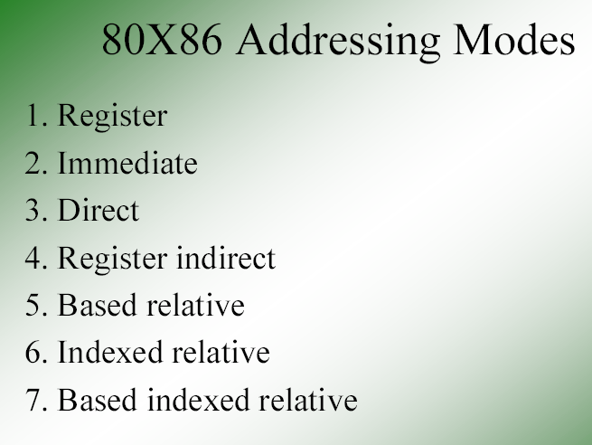
Addressing Modes – Accessing operands (data) in various ways

Slide 27
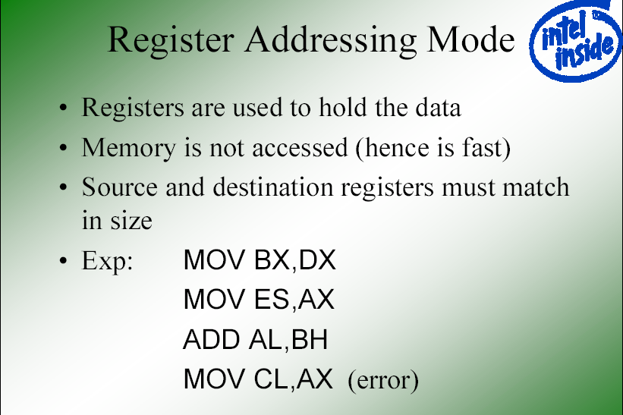

Slide 28
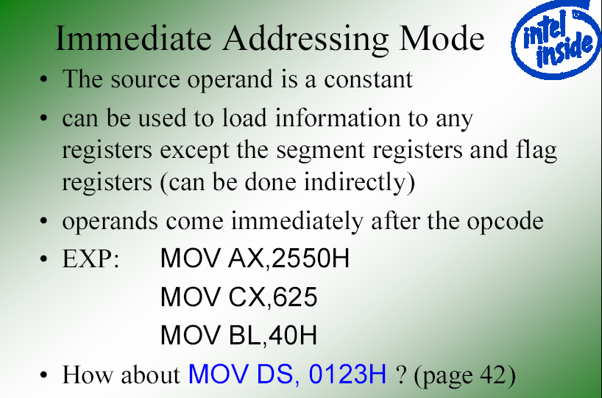

Slide 29
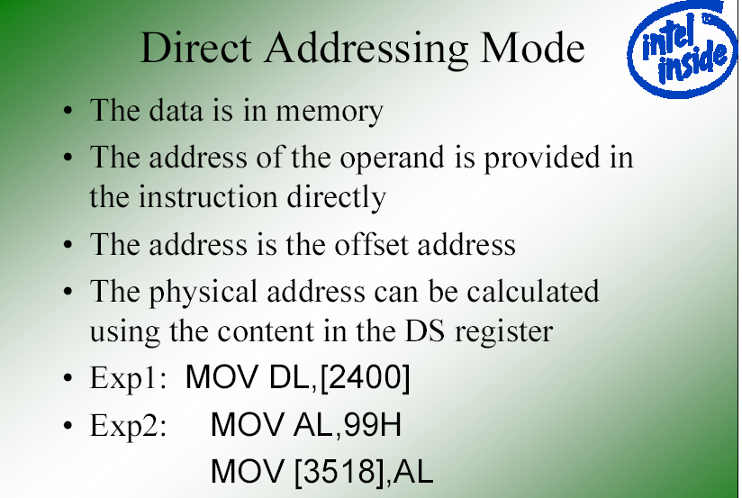
;move contents of DS:2400H into DL

Slide 30
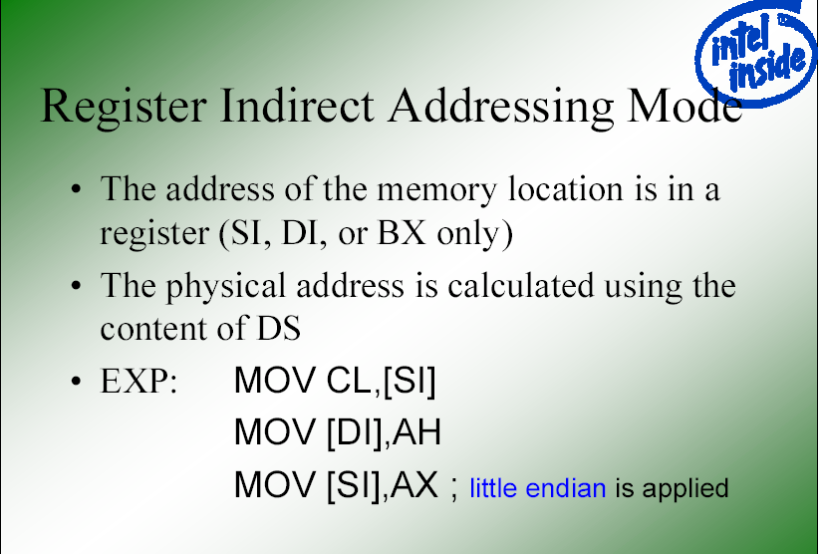
;move contents of DS:SI into CL
;move contents of AH into DS:DI
;moves contents of AX into memory
;locations DS:SI and DS:SI +1

Slide 31
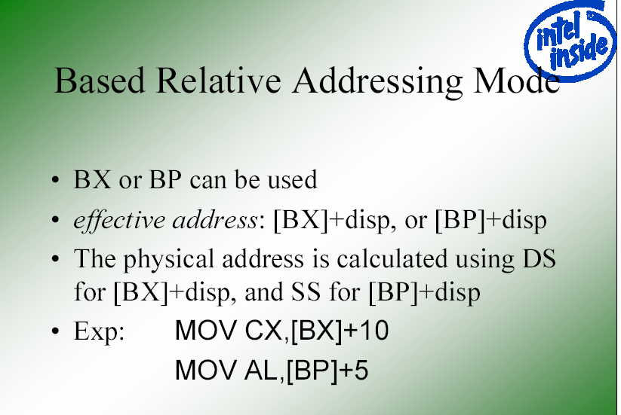
;move DS:BX+10 & DS:BX+10+1
;into CX. PA= DS(sl) +BX+10
;PA = SS (sl) + BP + 5

Slide 32
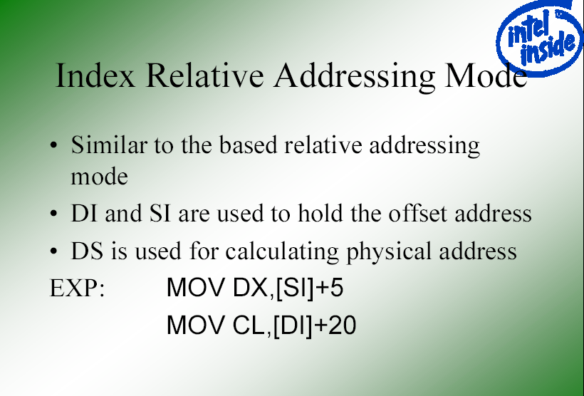
;PA = DS (sl) + SI + 5
;PA = DS (sl) + DI + 20

Slide 33
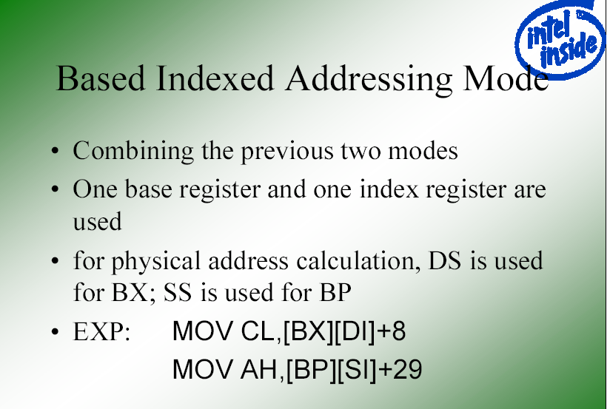
;PA=DS(sl)+BX+DI +8
;PA=SS(sl)+BP+SI +29

Slide 34
Question
Write a Program to move 5 bytes from a Location to another Location
Hint: use SI to DI registers…..

Slide 35
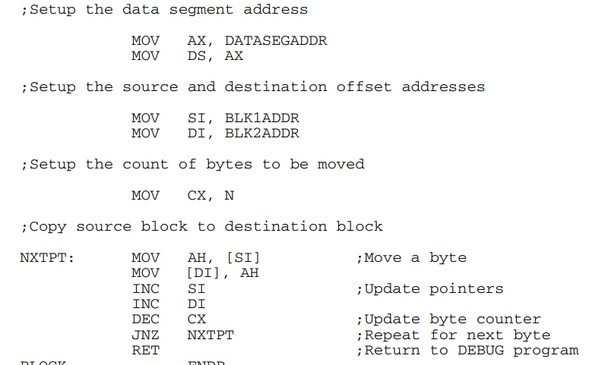
Solution

Slide 36
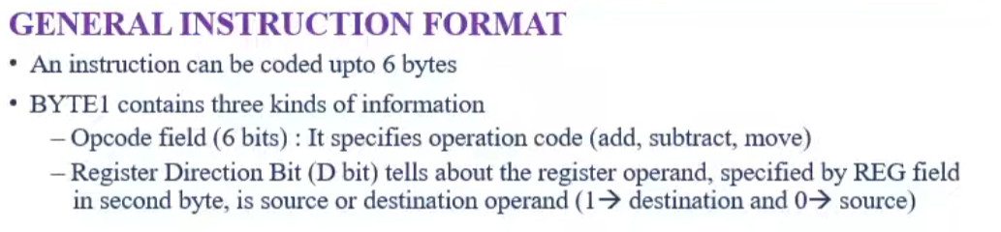
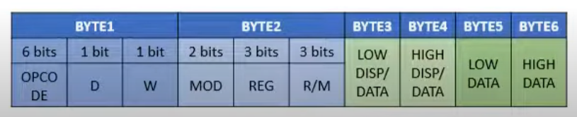


Slide 37
Thank You

